Slide 1
Implementing Domain Driven Design (DDD)
a practical guide

Slide 2


ABOUT ME Halil İbrahim Kalkan
Co Founder
Web: halilibrahimkalkan.com
Github: @hikalkan
Twitter: @hibrahimkalkan

Slide 3
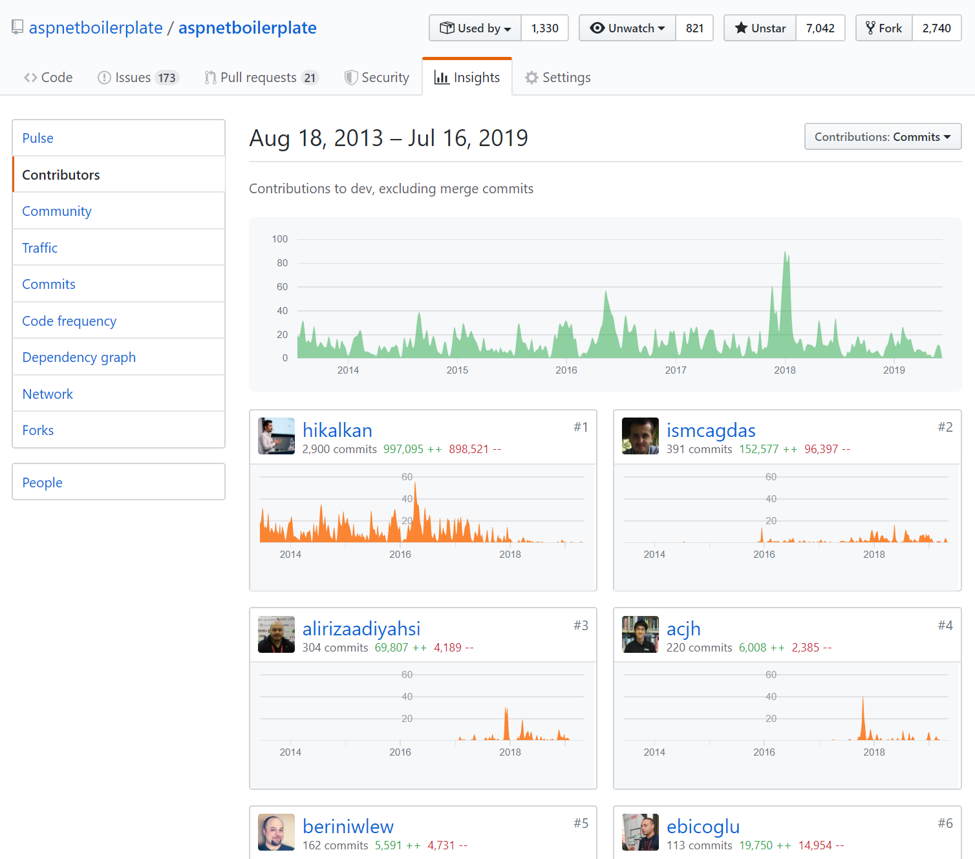
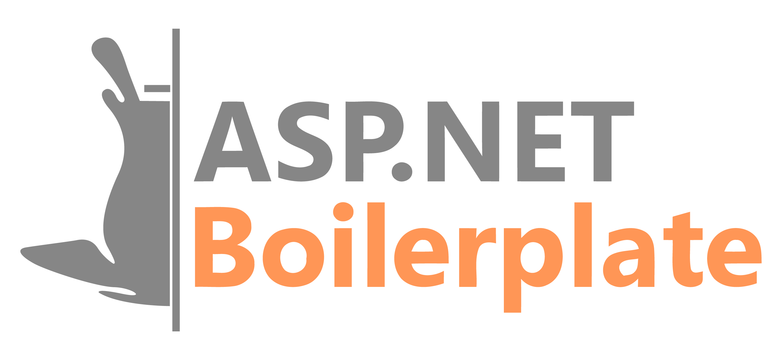
ASP.NET BOILERPLATE
7.000+ stars on GitHub
1.300.000+ downloads on Nuget
https://aspnetboilerplate.com

Slide 4
Agenda
Part-I: What is DDD?
Architecture & layers
Execution flow
Building blocks
Common principles
Part-II: Implementing DDD
Layering a Visual Studio solution
Rules & samples

Slide 5
Part-I: What is DDD?

Slide 6
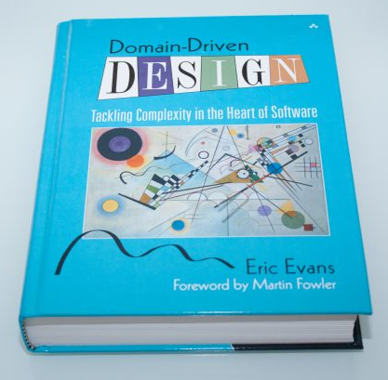
What is DDD?
Domain-driven design (DDD) is an approach to software development for complex needs by connecting the implementation to an evolving model
Focuses on the core domain logic.
Suitable for complex domains and large-scale applications.
Helps to build a flexible, modular and maintainable code base, based on the Object Oriented Programming principles.

Slide 7
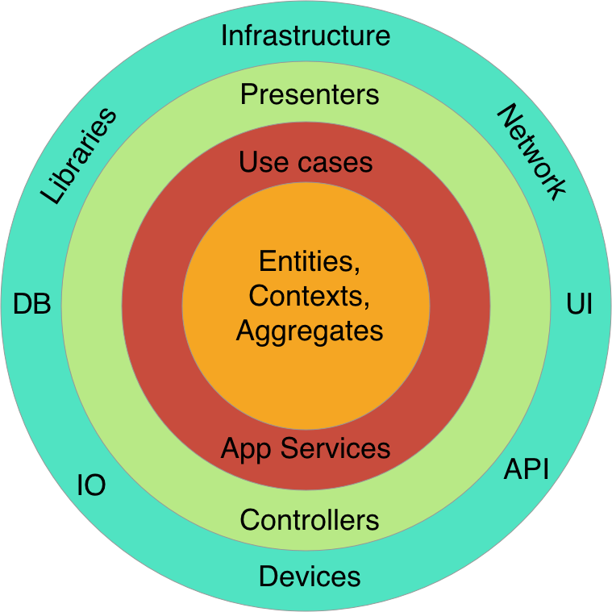
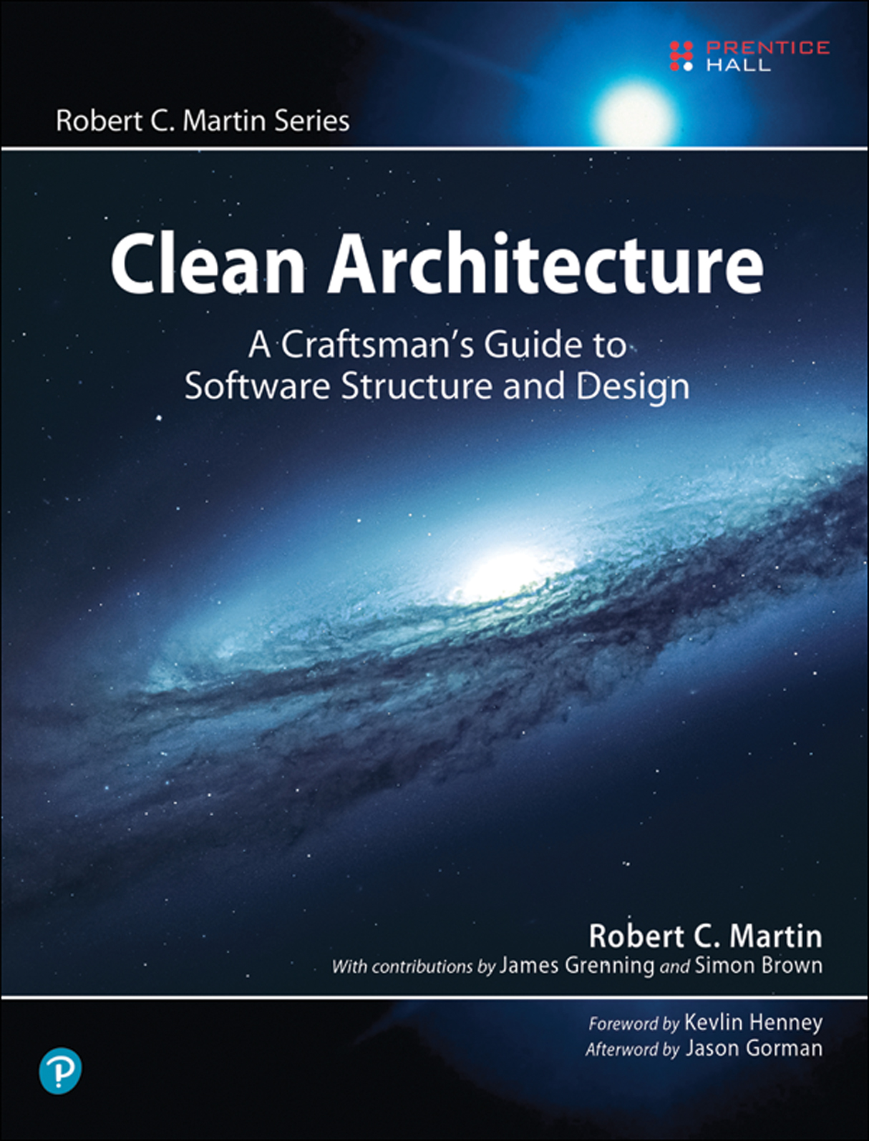
Domain Driven Design Layers / Clean Architecture
Infrastructure
Layer
Presentation Layer
Application Layer
Domain Layer

Slide 8

Domain Driven Design Execution Flow
PRESENTATION layer
APPLICATION layer
DOMAIN layer
HTTP request
Entities
Browsers
MVC UI
DTO
html/js/css
Application
Services
Domain Services
HTTP request
Remote clients
HTTP API
DTO
Repositories (interface)
JSON
Distributed Services
Layer
Authorization
Validation
Exception Handling
Audit Logging
Caching
Authorization
Validation
Audit Logging
Unit of Work / DB Transaction
C r o s s C u t t i n g C o n c e r n s

Slide 9
Domain Driven Design Core Building Blocks
Domain Layer
Entity
Value Object
Aggregate & Aggregate Root
Repository
Domain Service
Specification
Domain Event
Application Layer
Application Service
Data Transfer Object (DTO)
Unit of Work

Slide 10
Domain Driven Design Common Principles
Database / ORM independence
Presentation technology agnostic
Doesn’t care about reporting / mass querying
Focuses on state changes of domain objects

Slide 11
Part-II: Implementation
Implementing Domain Driven Design (DDD)

Slide 12
Aggregates Example
Label Aggregate
Issue Aggregate
Label (agg. root)
Issue (aggregate root)
Comment (entity)
Guid Id
--------------------------------------
string Name
string Color
…
Repository (agg. root)
Guid Id
--------------------------------------
string Text
bool IsClosed
Enum CloseReason
--------------------------------------
Guid RepositoryId
Guid AssignedUserId
--------------------------------------
ICollection<Comment>
ICollection<IssueLabel>
Guid Id
--------------------------------------
string Text
DateTime CreationTime
--------------------------------------
Guid IssueId
Guid UserId
Guid Id
--------------------------------------
string Name
…
…
User (agg. root)
IssueLabel (value obj)
Guid Id
--------------------------------------
string UserName
string Password
…
Guid IssueId
Guid LabelId
Repository
Aggregate
Other (entity)
Guid Id
--------------------------------------
…
…
User Aggregate

Slide 13
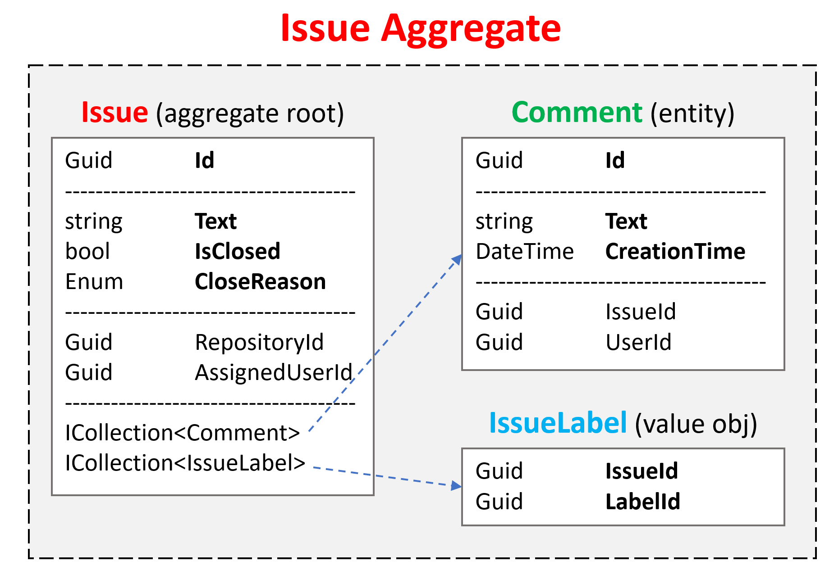
Aggregate Roots Principles
Saved & retrieved as a single unit (with sub-collections)
Should maintain self integrity & validity by implementing domain rules & constraints
Responsible to manage sub entities/objects
An aggregate is generally considered as a transaction boundary.
Should be serializable (already required for NoSQL databases)

Slide 14
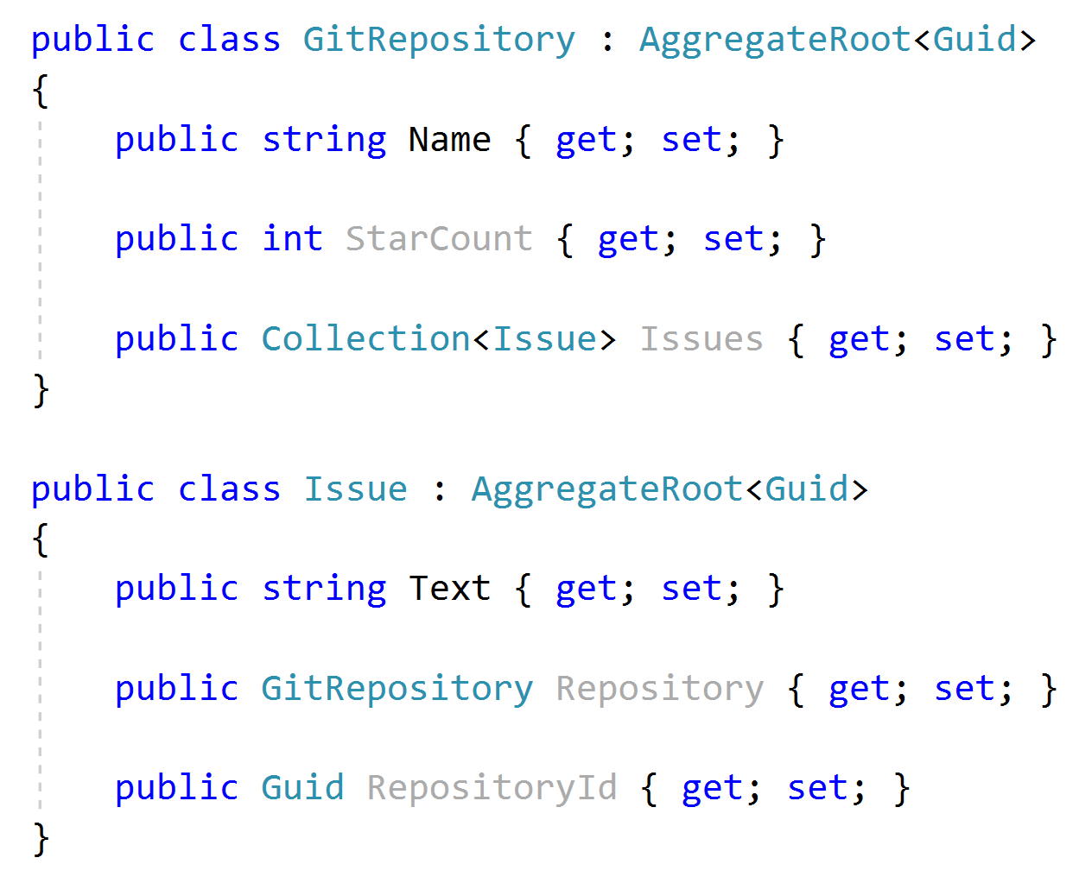


Aggregate Roots Rule: Reference Other Aggregates only by Id

Slide 15
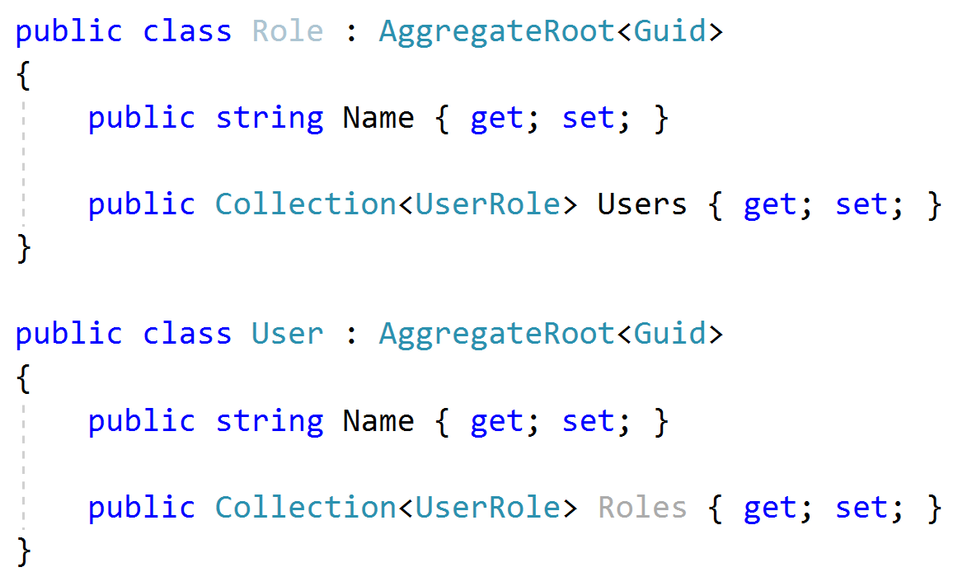
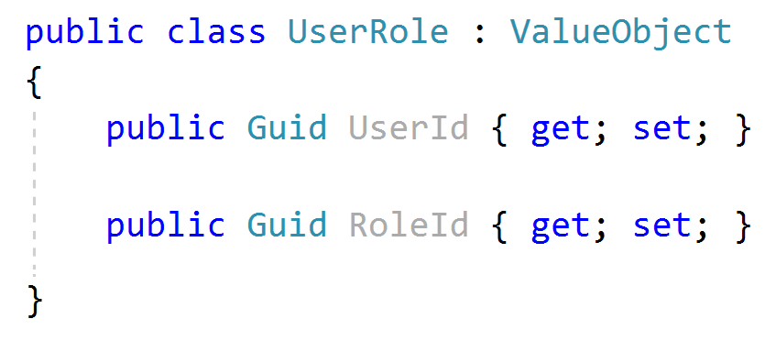
Aggregate Roots Tip: Keep it Small
Considerations;
Query Performance
Data Integrity & Validity
Objects used together

Slide 16
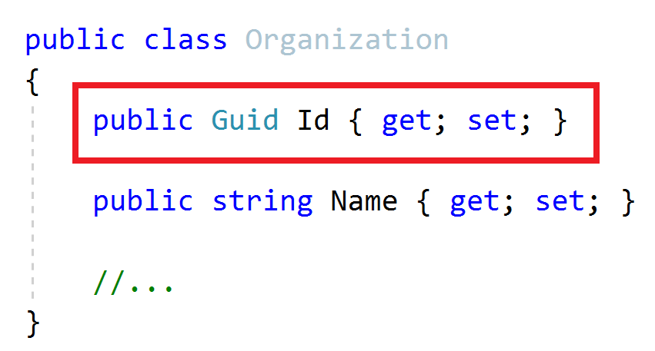
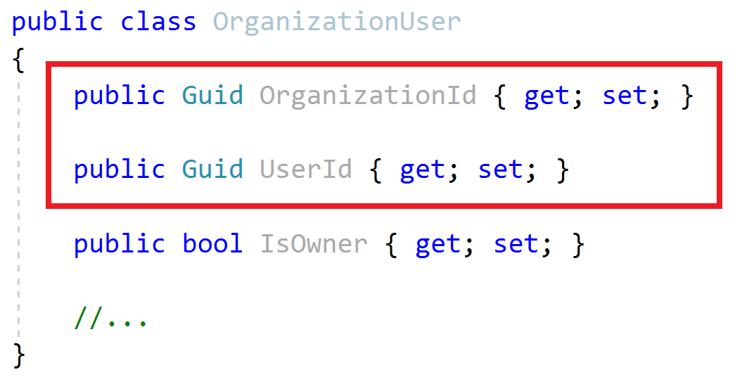
Aggregate Roots / Entities Primary Keys
Aggregate Root
Entity
Define a single Primary Key (Id)
Can define a composite Primary Key
Suggestion: Prefer GUID as the PK

Slide 17
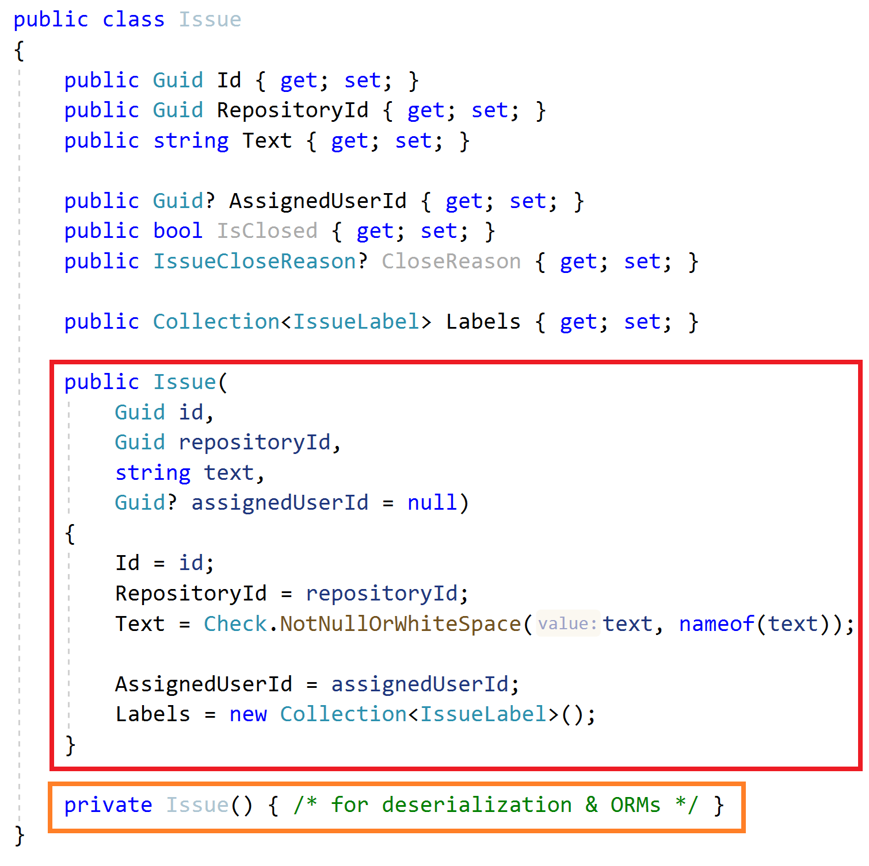
Aggregate Roots & Entities Constructor
Force to create a VALID entity
Get minimum required arguments
Initialize sub collections
Create a private default constructor for ORMs & deserialization
Get id as an argument (don’t use Guid.NewGuid())
Use a service to create GUIDs, like IGuidGenerator

Slide 18
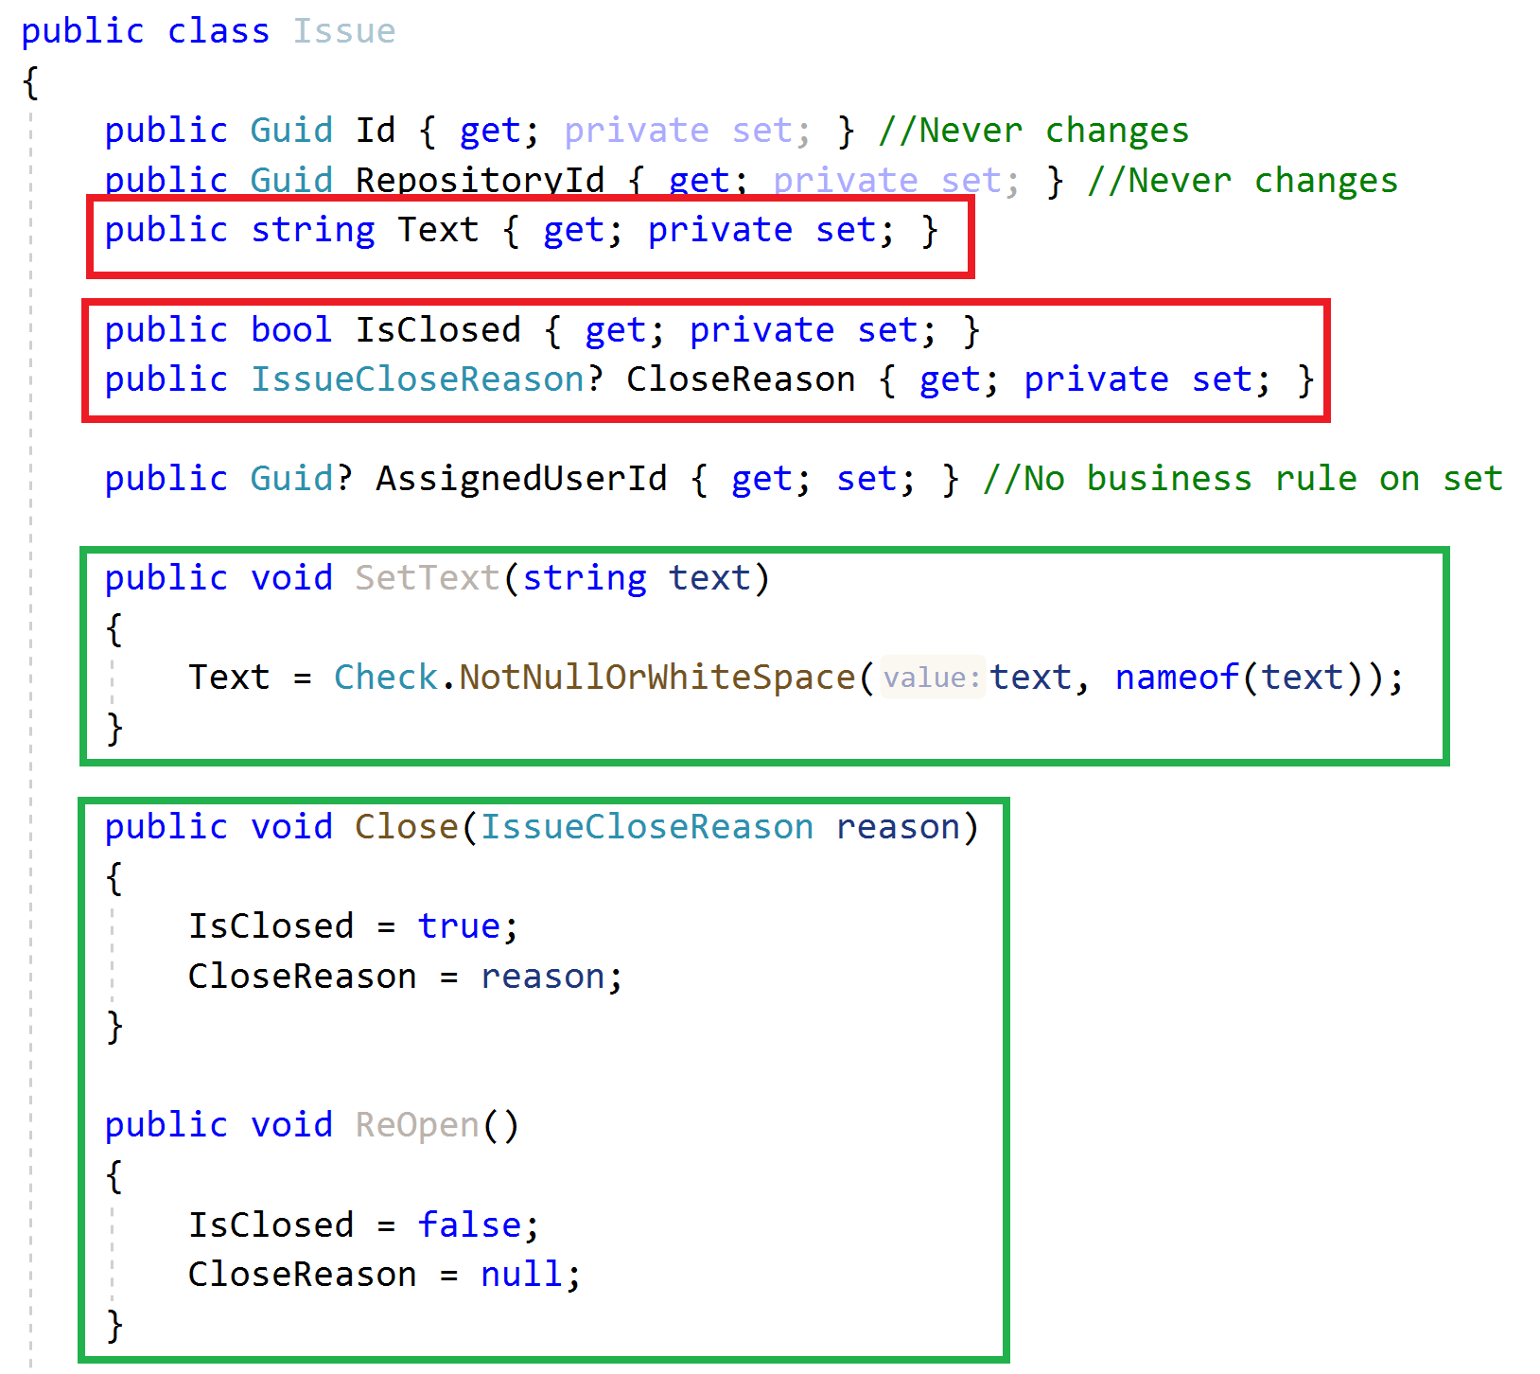
Aggregate Roots & Entities Property Accessors & Methods
Maintain object validity
Use private setters when needed
Change properties via methods

Slide 19
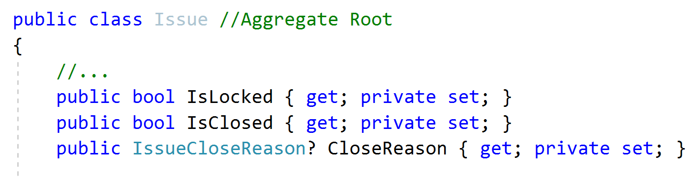
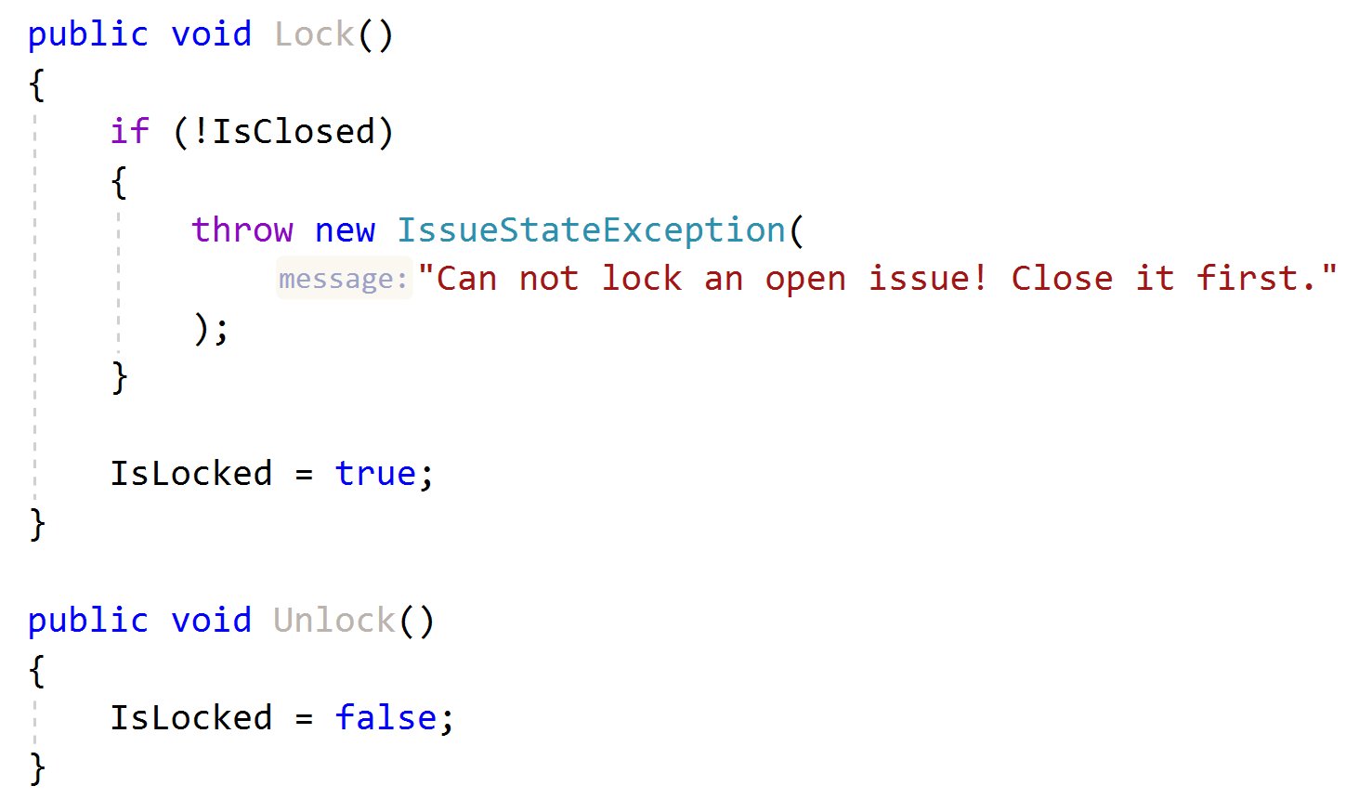
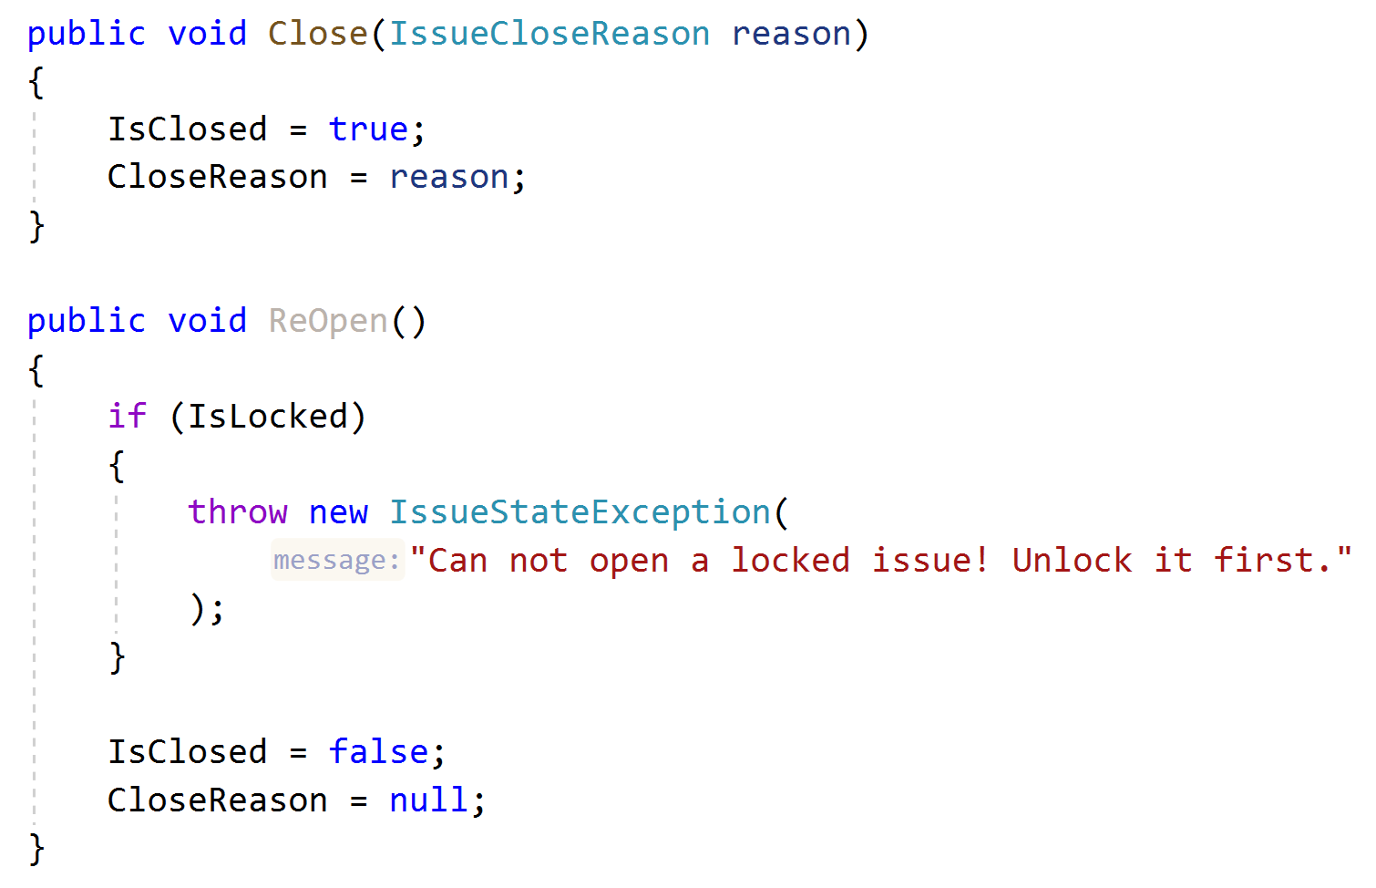
Aggregate Roots & Entities Business Logic & Exceptions
Implement Business Rules
Define and throw specialized exceptions

Slide 20
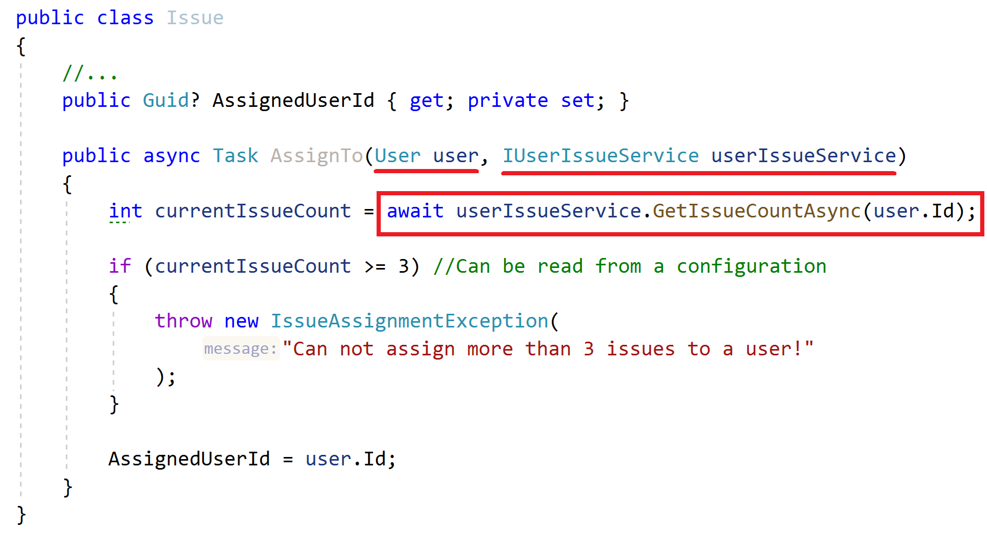
Aggregate Roots & Entities Business Logic
How to implement when you need external services?
Business Rule: Can not assign more than 3 issues to a user!

Slide 21
Aggregate Roots / Entities Business Logic
How to implement when you need external services?
Business Rule: Can not assign more than 3 issues to a user!
ALTERNATIVE..?
Create a Domain Service!

Slide 22
Repositories Principles
A repository is a collection-like interface to interact with the database to read and write entities
Define interface in the domain layer, implement in the infrastructure
Do not include domain logic
Repository interface should be database / ORM independent
Create repositories for aggregate roots, not entities

Slide 23
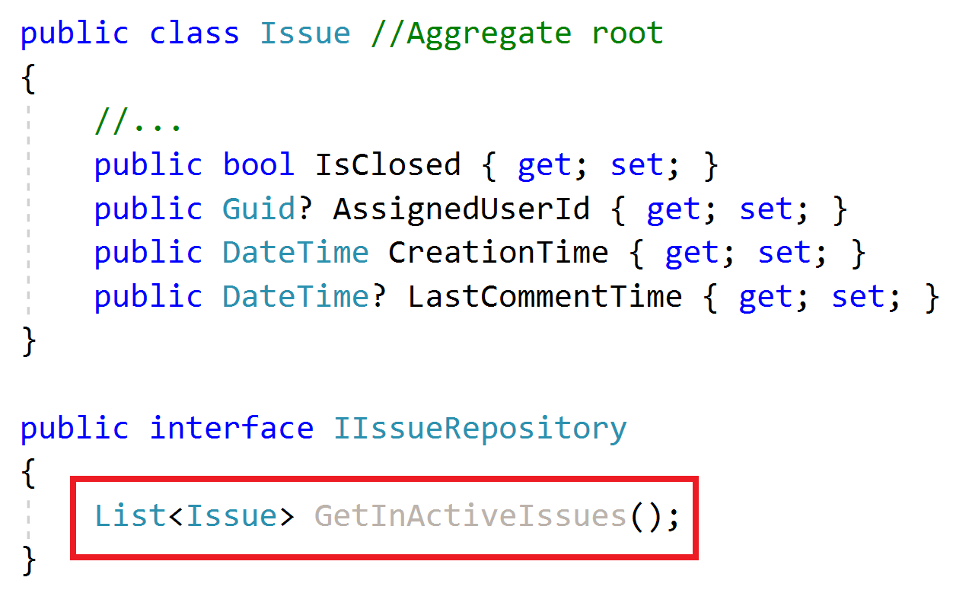
Repositories Do not Include Domain Logic
What is an In-Active issue?

Slide 24
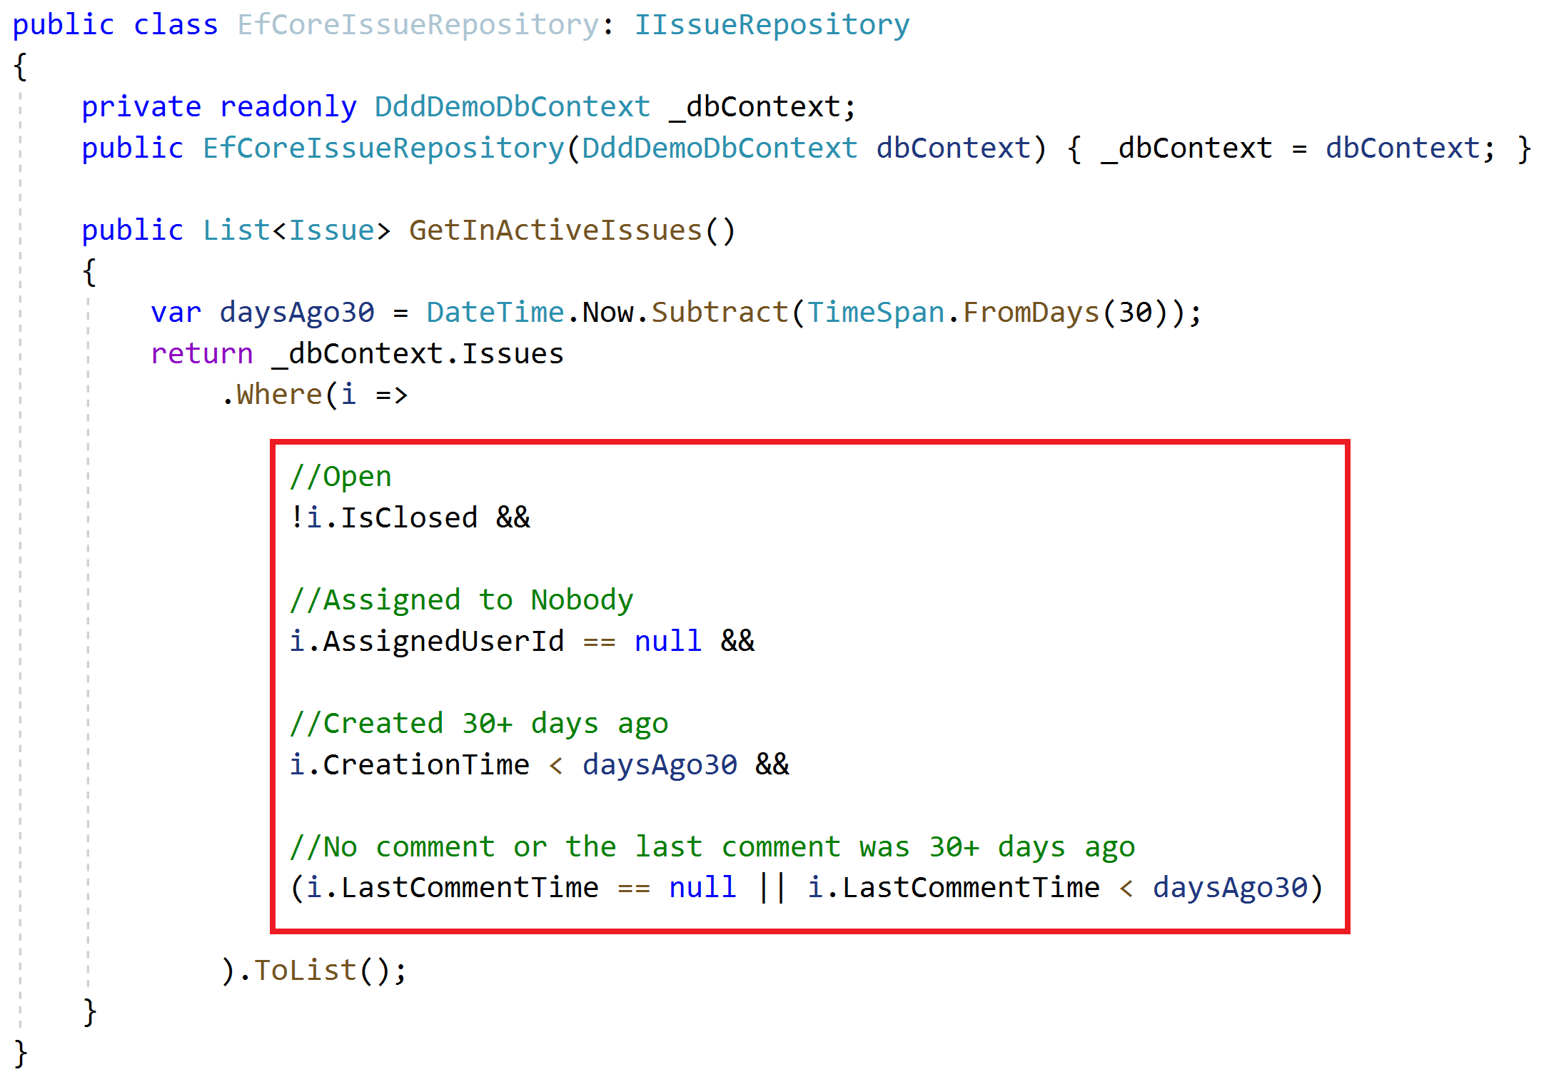
Repositories Do not Include Domain Logic
Implicit definition of a domain rule!
How to re-use this expression?

Slide 25
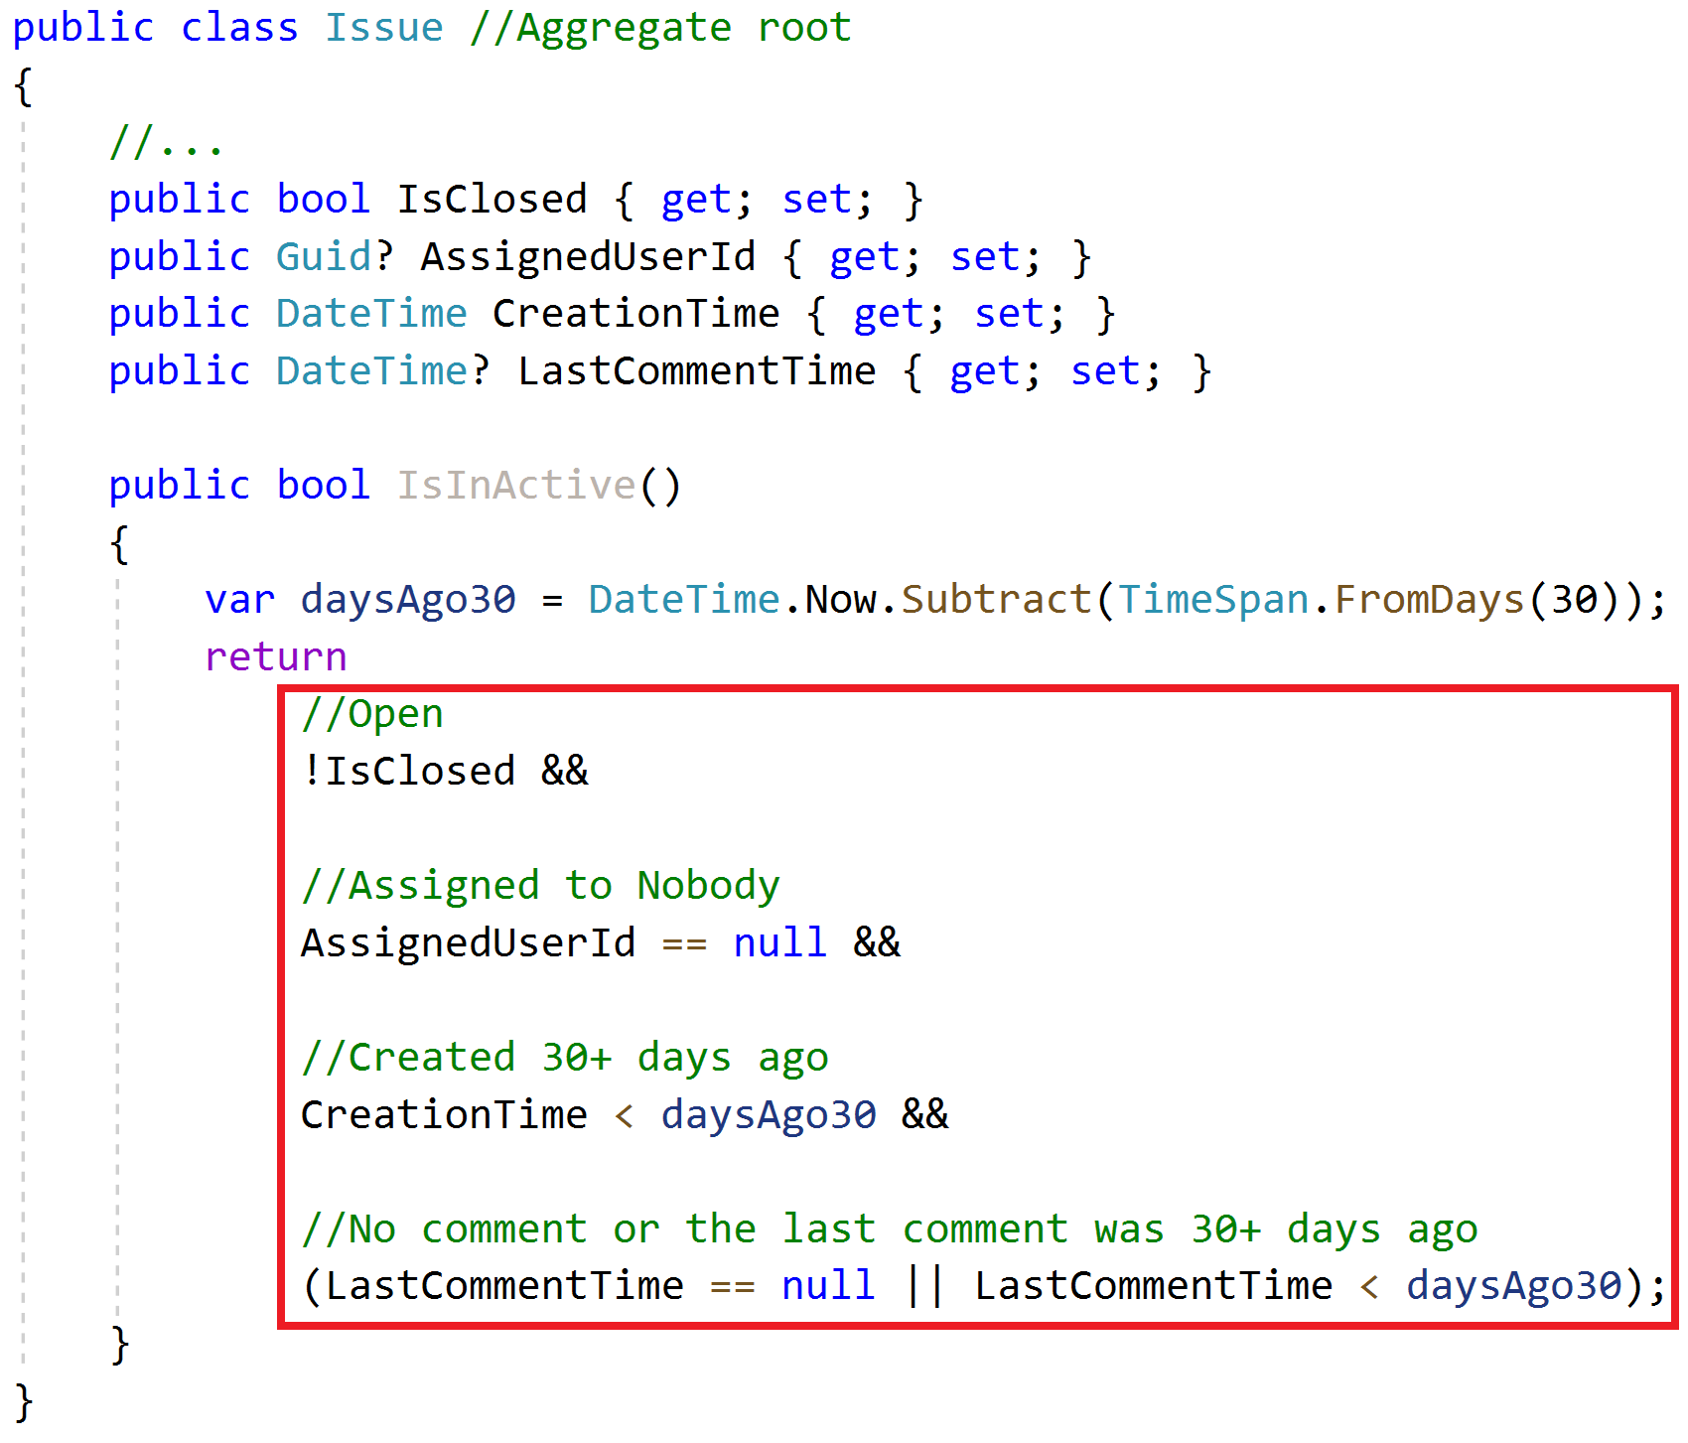
Repositories Do not Include Domain Logic
Implicit definition of a domain rule!
How to re-use this expression?
Copy/paste?
Solution: The Specification Pattern!

Slide 26
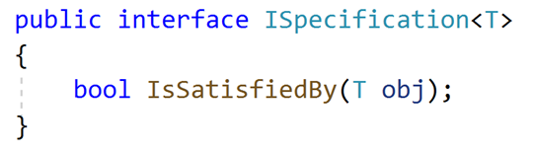
Specifications
A specification is a named, reusable & combinable class to filter objects.

Slide 27
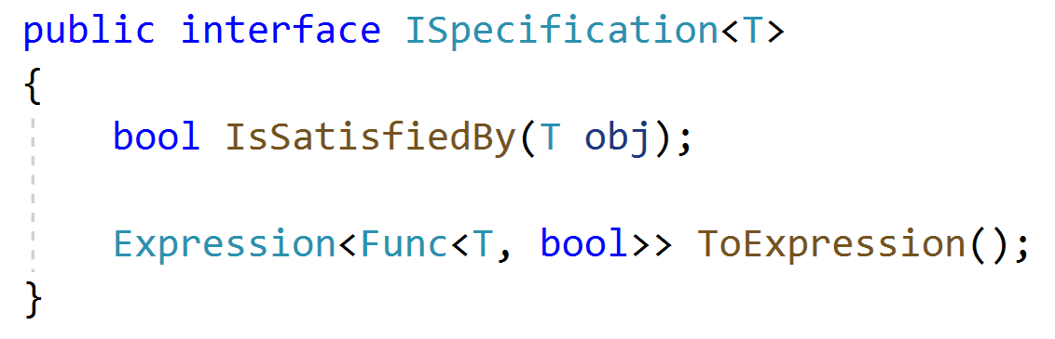
Specifications
A specification is a named, reusable & combinable class to filter objects.

Slide 28
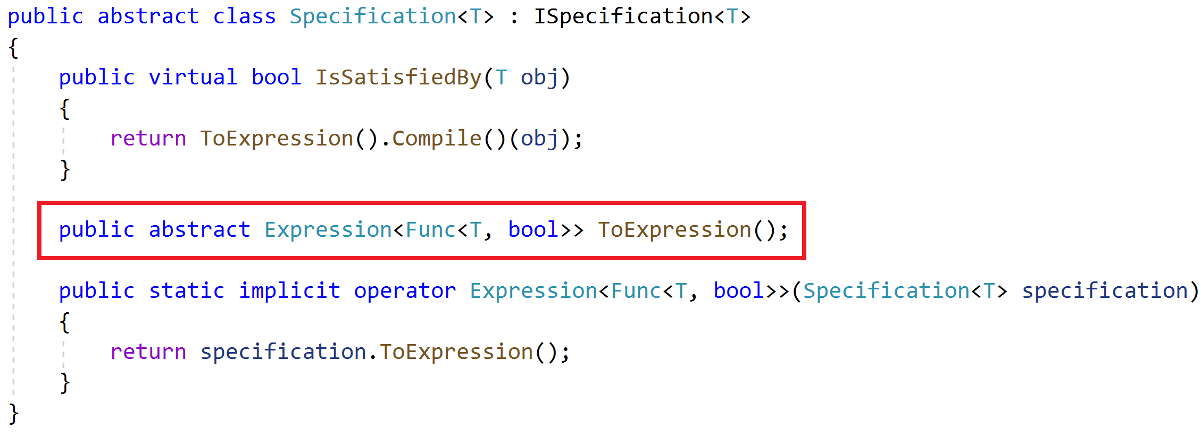
Specifications
A specification is a named, reusable & combinable class to filter objects.

Slide 29
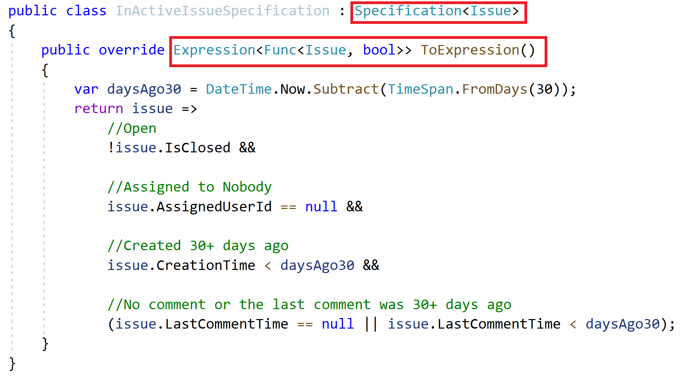
Specifications Define a Specification

Slide 30
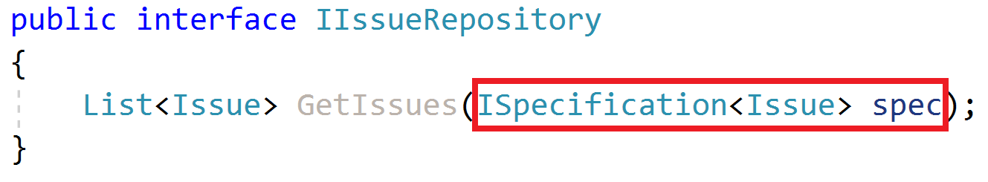
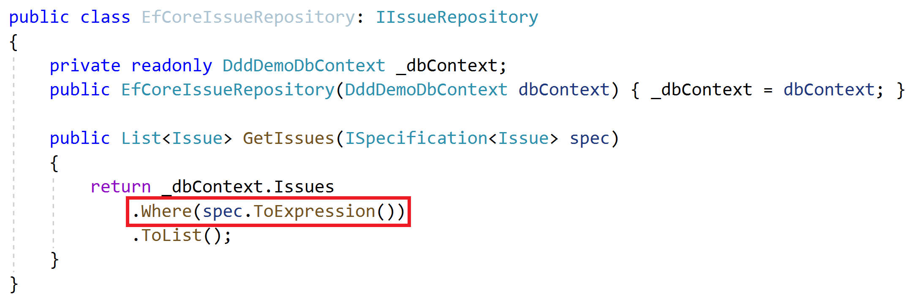
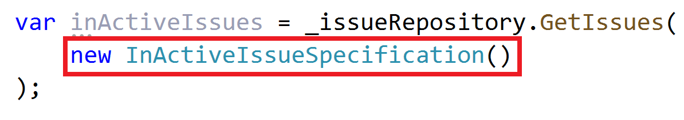
Specifications Use the Specification

Slide 31
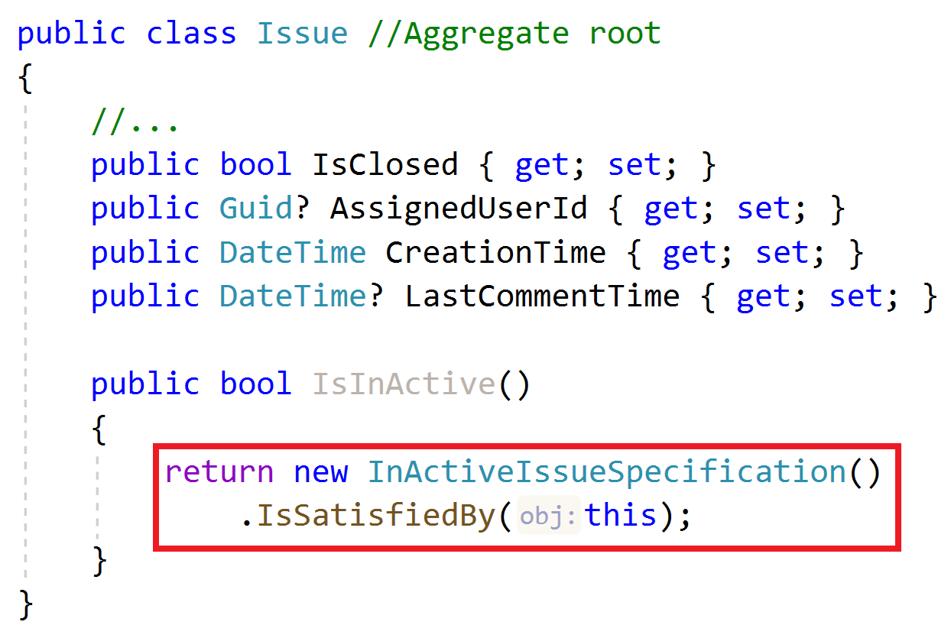
Specifications Use the Specification

Slide 32
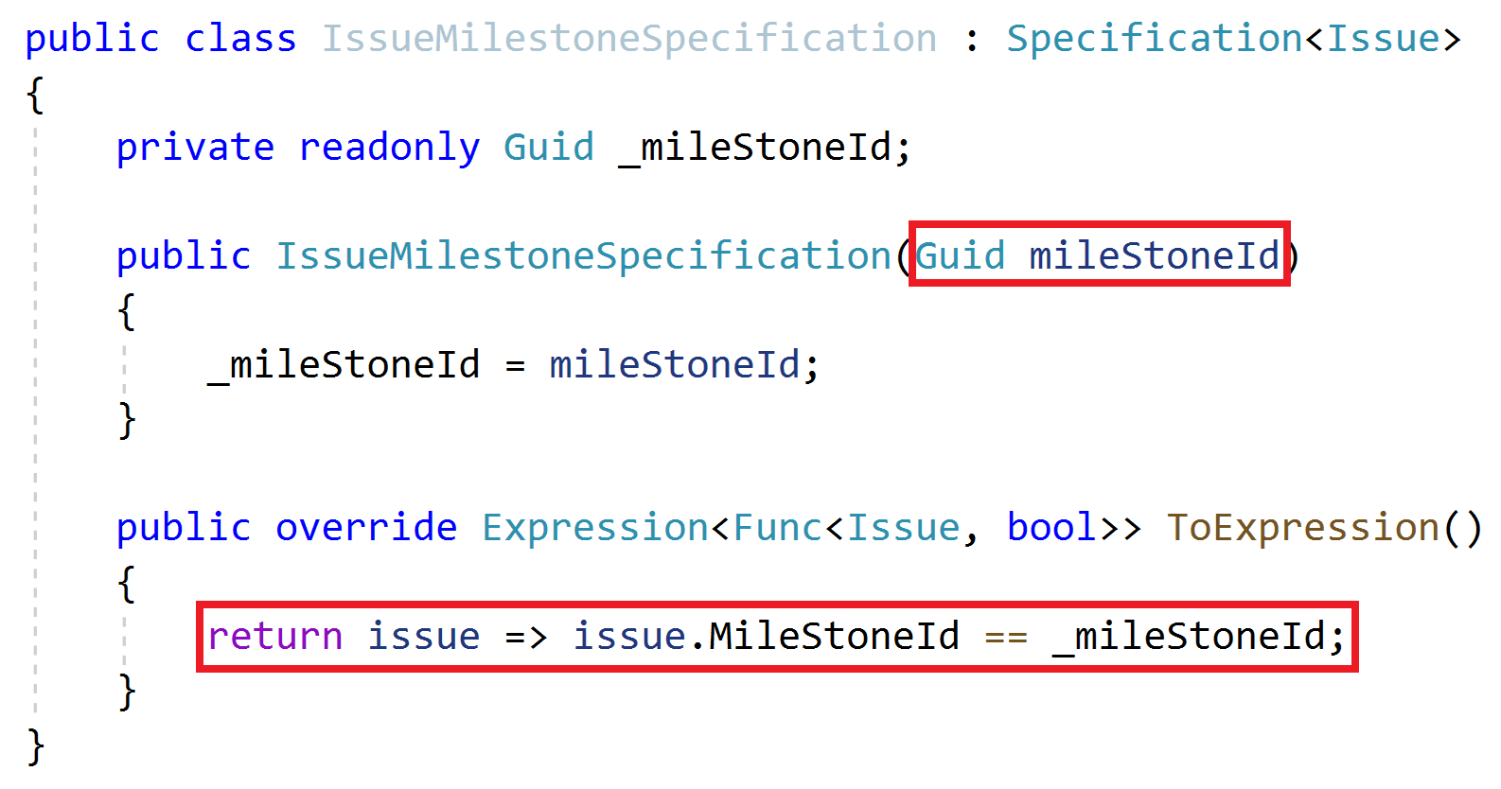
Specifications Combining Specifications

Slide 33
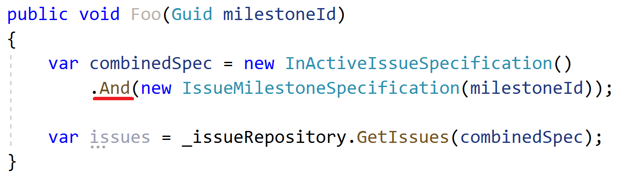
Specifications Combining Specifications

Slide 34
Domain Services Principles
Implements domain logic that;
Depends on services and repositories
Needs to work with multiple entities / entity types
Create for aggregate roots, not for entities
Work with domain objects, not DTOs

Slide 35
Domain Services Example
Business Rule: Can not assign more than 3 issues to a user

Slide 36
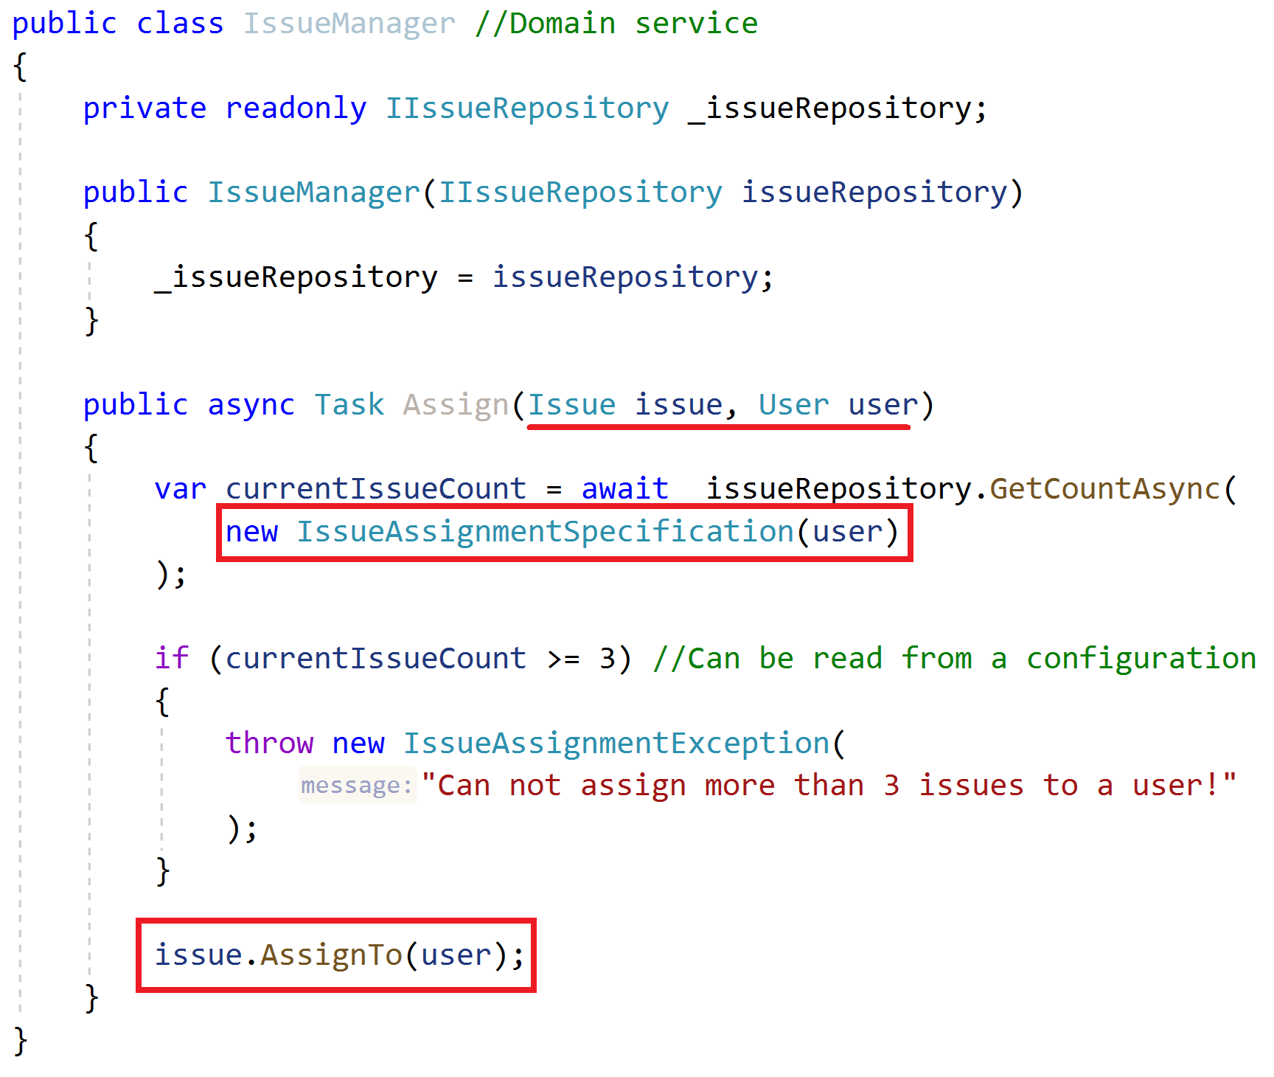
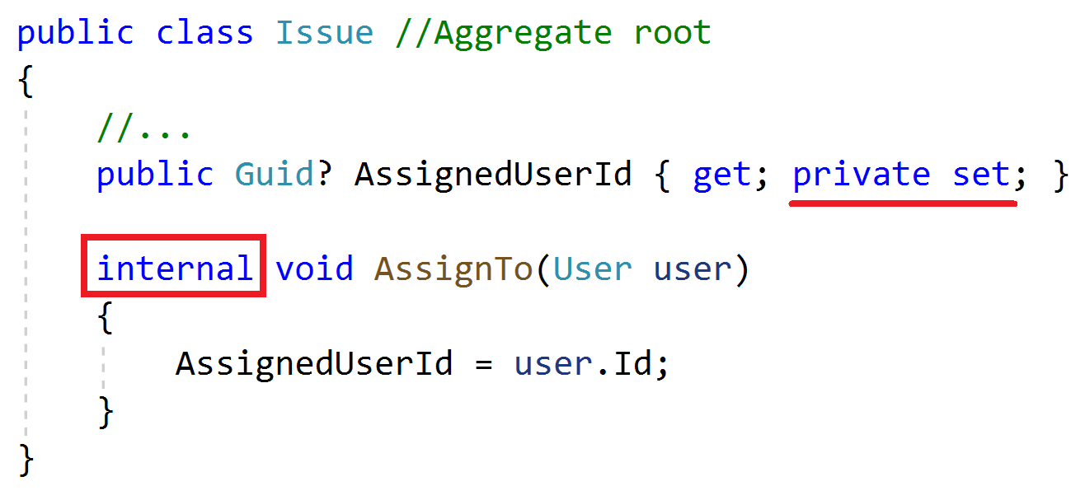
Domain Services Example

Slide 37
Application Services Principles
Implement use cases of the application (application logic), not domain logic!
Get & return Data Transfer Objects, not entities!
Use entities, repositories and other domain objects inside

Slide 38
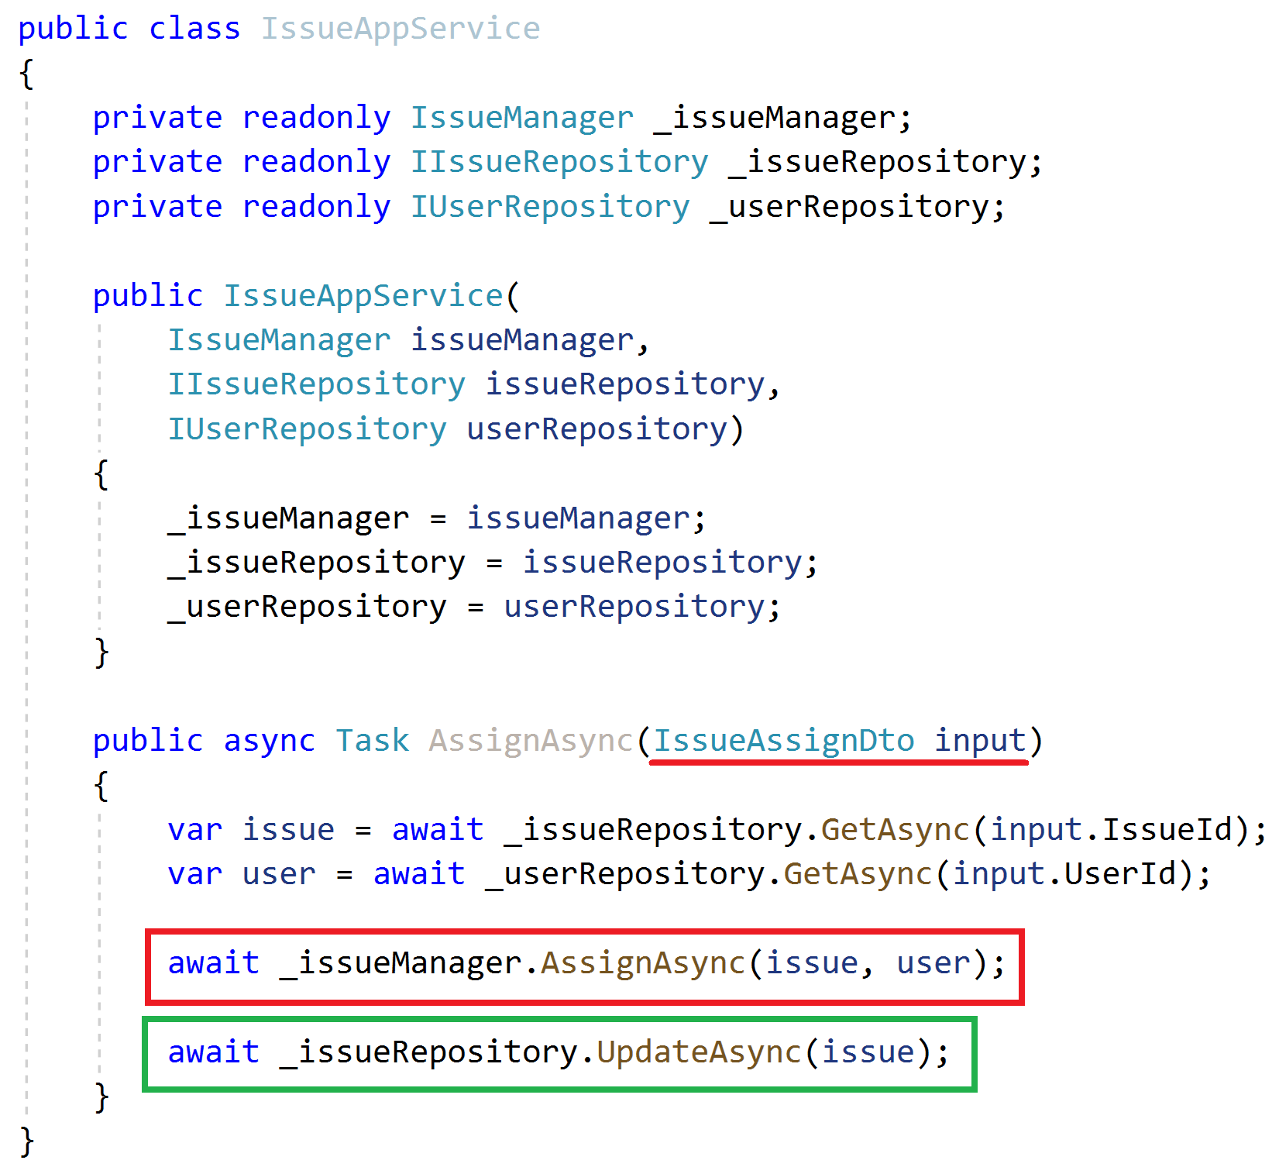
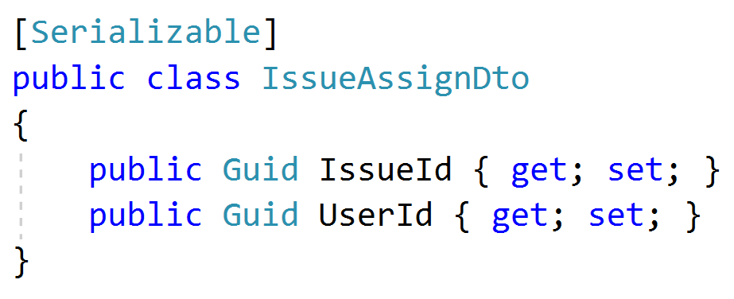
Application Services Example
Inject domain services & repositories
Get DTO as argument
Get aggregate roots from repositories
Use domain service to perform the domain logic
Always update the entity explicitly (don’t assume the change tracking)

Slide 39
Application Services Common DTO best practices
Should be serializable
Should have a parameterless public constructor (implicit/explicit)
Should not contain any business logic
Never inherit from entities! Never reference to entities!

Slide 40
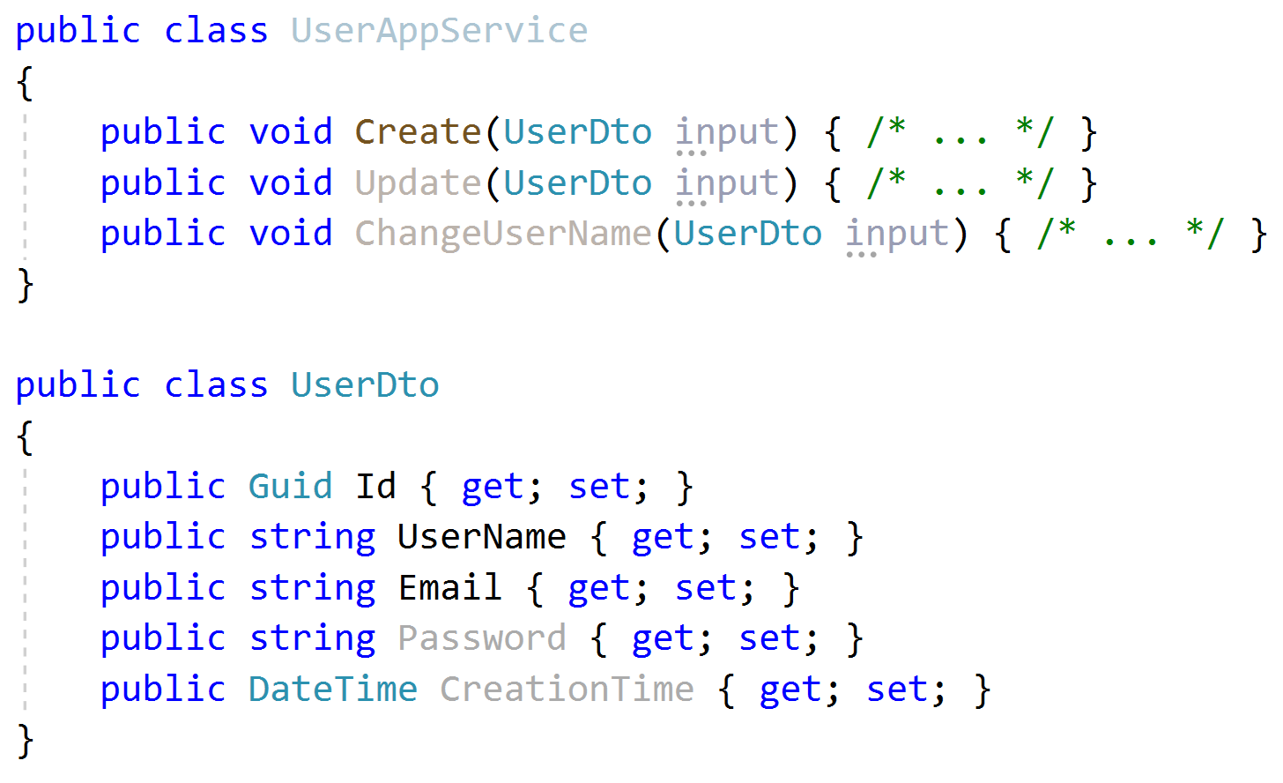
Application Services Input DTO best practices
Define only the properties needed for the use case
Do not reuse same input DTO for multiple use cases (service methods)
Id is not used in create! Do not share same DTO for create & update!
Password is not used in Update and ChangeUserName!
CreationTime should not sent by the client!

Slide 41
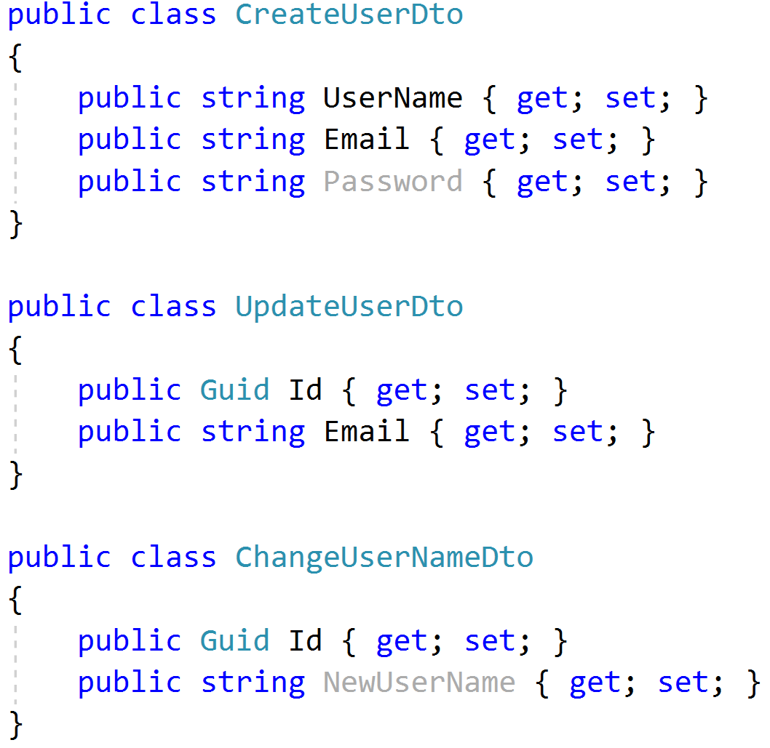
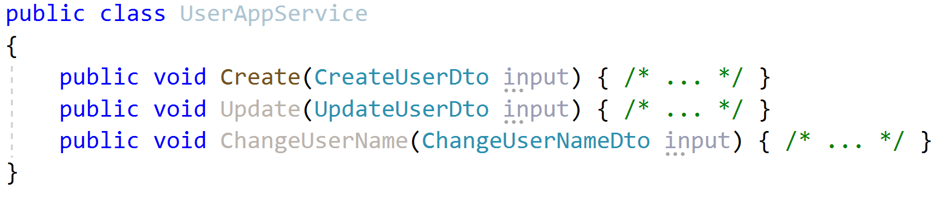
Application Services Input DTO best practices
Define only the properties needed for the use case
Do not reuse same input DTO for multiple use cases (service methods)

Slide 42
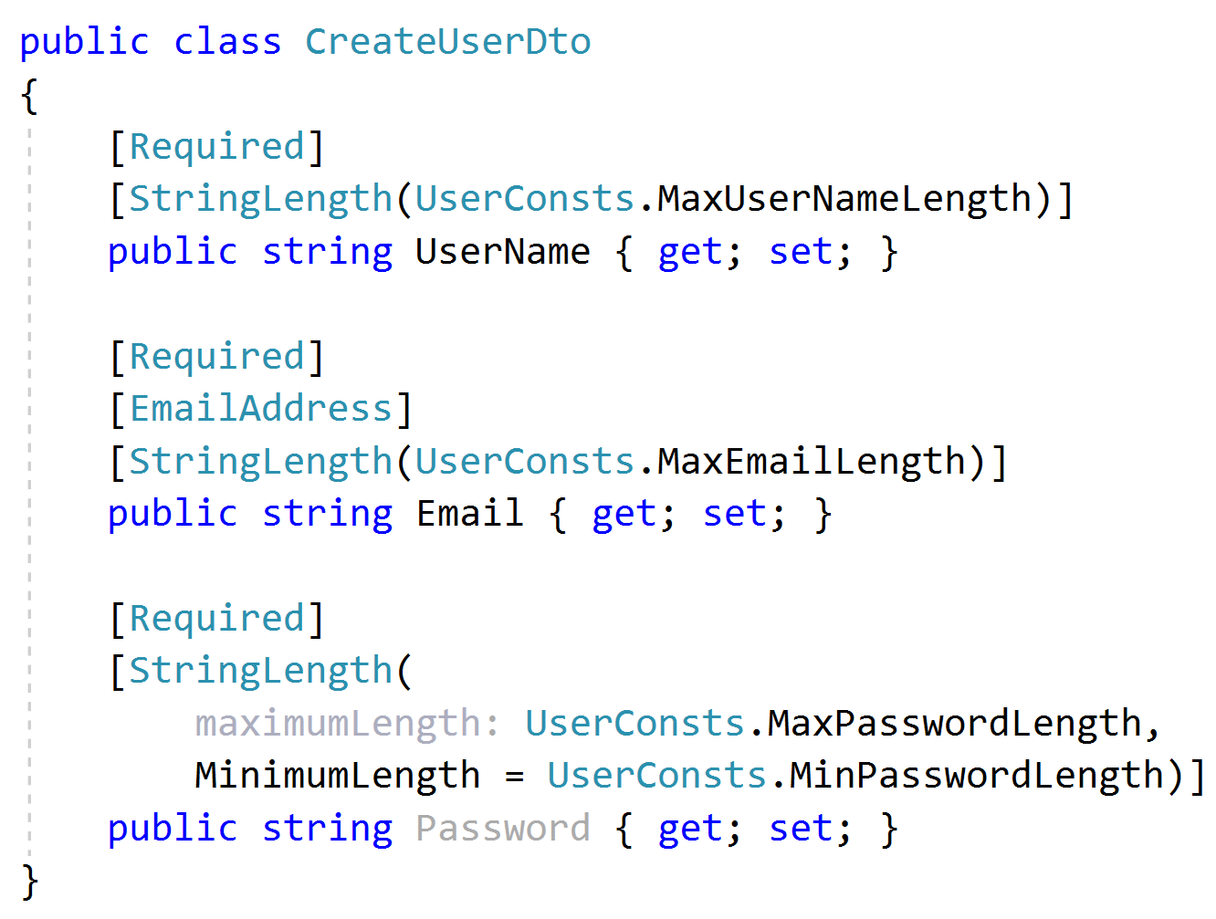
Application Services Input DTO best practices
Implement only the formal validation (can use data annotation attributes)
Don’t include domain validation logic (ex: unique user name constraint)

Slide 43
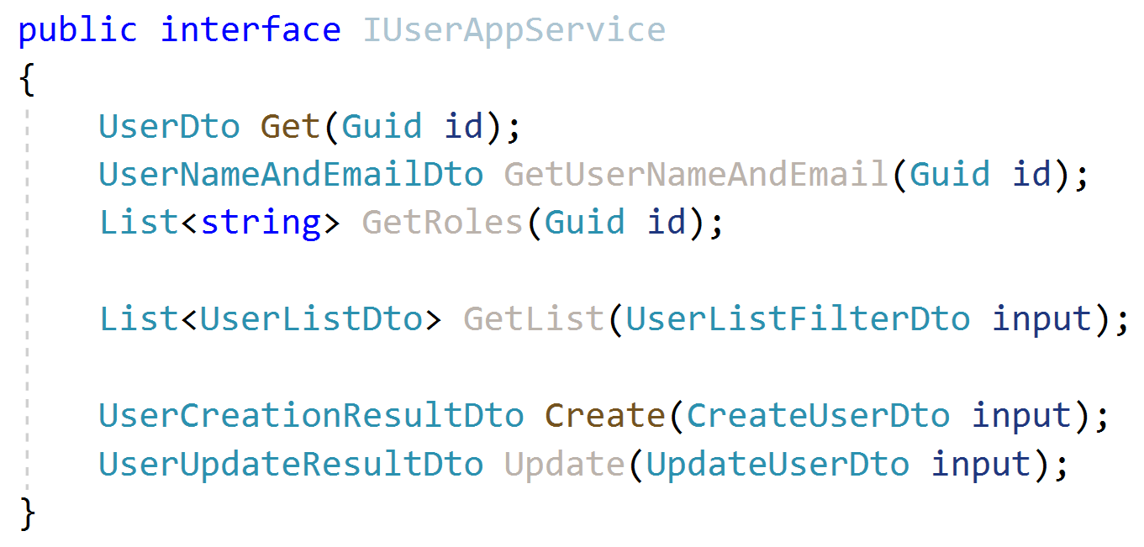
Application Services Output DTO suggestions
Keep output DTO count minimum. Reuse where possible (except input DTOs as output DTO).
Return the entity DTO from Create & update methods.
Can contain more data than client needs
Exception: Where performance is critical, especially for large result sets.

Slide 44
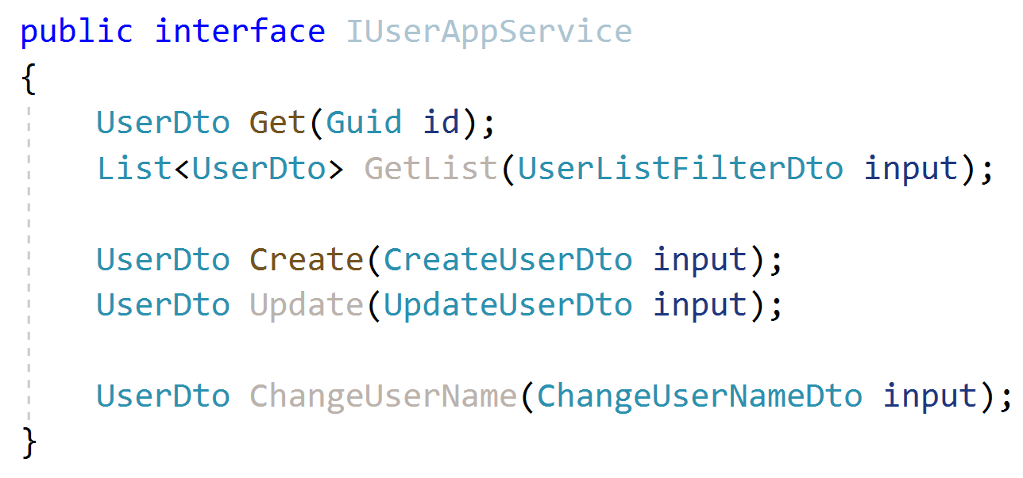
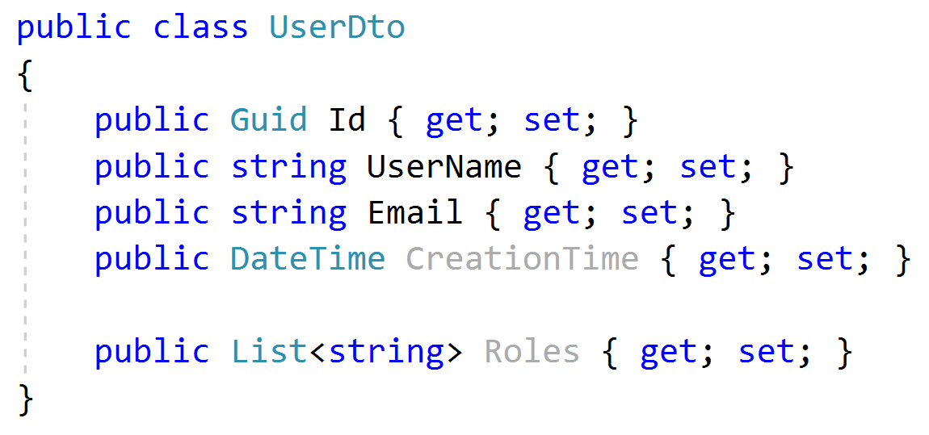
Application Services Output DTO suggestions
Keep output DTO count minimum. Reuse where possible (except input DTOs as output DTO).
Return the entity DTO from Create & update methods.
Can contain more data than client needs
Exception: Where performance is critical, especially for large result sets.

Slide 45
Application Services Object to Object Mapping
Use auto object mapping libraries (but, carefully – enable configuration validation)
Do not map input DTOs to entities. Map entities to output DTOs

Slide 46
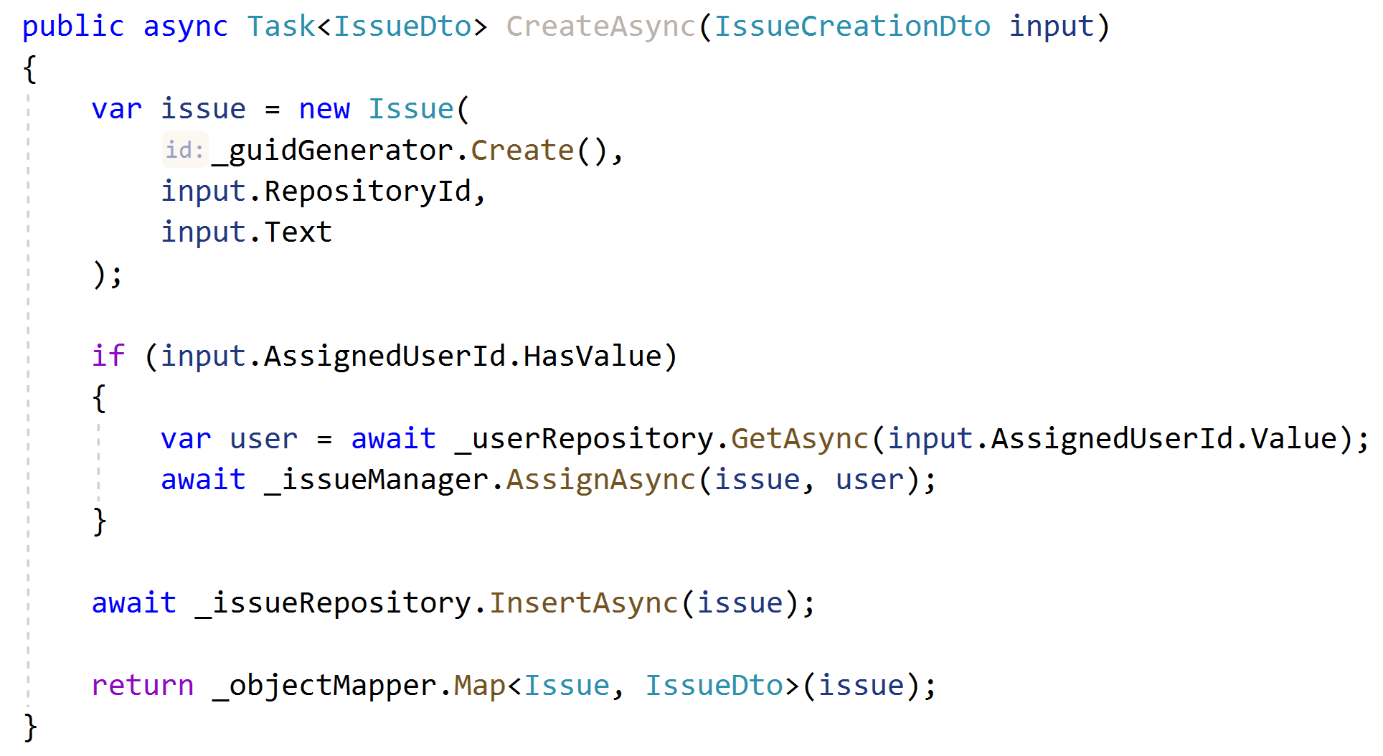
Application Services Example: Entity Creation
Don’t use DTO to entity auto-mapping, use entity constructor.
Perform additional domain actions.
Use repository.
Return DTO using auto-mapping.

Slide 47
Domain/Business Exceptions
Do not return null or operation result code for exceptional cases, throw exceptions!
Define exception classes for important business rules
Include an error code in the exception
Separate localization from exception throwing
Map exceptions to HTTP status codes

Slide 48
Domain/Business Exceptions

